Slide 1
Chest X-ray scoring system은 다음과 같이 할 예정입니다.
Upper zones (A and D): above the inferior wall of the aortic arch
Middle zones (B and E): below the inferior wall of the aortic arch and above the inferior wall of the right inferior pulmonary vein (i.e., the hilar structures)
Lower zones (C and F): below the inferior wall of the right inferior pulmonary vein (i.e., the lung bases)
Score 0 no lung abnormalities
Score 1 interstitial infiltrates
Score 2 interstitial and alveolar infiltrates (interstitial predominance)
Score 3 interstitial and alveolar infiltrates (alveolar predominance)
Borghesi La radiologia medica 2020

Slide 2
Chest X-ray scoring system: Division of lungs into six zones
Division of lungs into six zones on frontal chest radiograph.
Line A is drawn at the level of the inferior wall of the aortic arch.
Line B is drawn at the level of the inferior wall of the right inferior pulmonary vein.
A and D upper zones; B and E middle zones; C and F lower zones
Borghesi La radiologia medica 2020

Slide 3
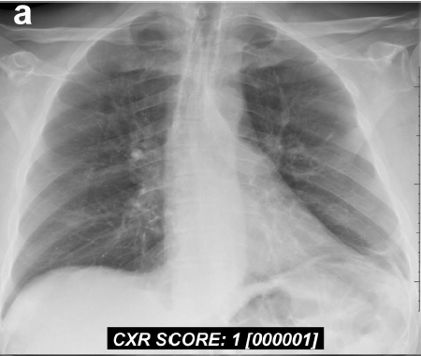
Chest X-ray scoring system: Examples, 다음과 같이 점수를 매기고 이를 인공지능에게 학습시킬 예정입니다.
Borghesi La radiologia medica 2020

